Slide 1
Day6
Numpy

Slide 2
NumPy
NumPy is a Python library.
NumPy stands for numeric python which is a python package for the computation and processing of the multidimensional and single dimensional array elements.

Slide 3
Installation
Pip install numpy

Slide 4
NumPy Ndarray
Ndarray is the n-dimensional array object defined in the numpy which stores the collection of the similar type of elements.
a = numpy.array
numpy.array(object, dtype = None, copy = True, order = None, subok = False, ndmin = 0)

Slide 5
Contd..
Object:It represents the collection object. It can be a list, tuple, dictionary, set, etc.
Dtype:We can change the data type of the array elements by changing this option to the specified type. The default is none.
copy :It is optional. By default, it is true which means the object is copied.
Order:There can be 3 possible values assigned to this option. It can be C (column order), R (row order), or A (any)
Subok:The returned array will be base class array by default. We can change this to make the subclasses passes through by setting this option to true.
Ndmin:It represents the minimum dimensions of the resultant array.

Slide 6
Contd..
A.itemsize –size of each data in bytes
A.ndim –dimention of array
A.dtype –type of items in array
A.size –size of array
A.shape –dimension of array

Slide 7
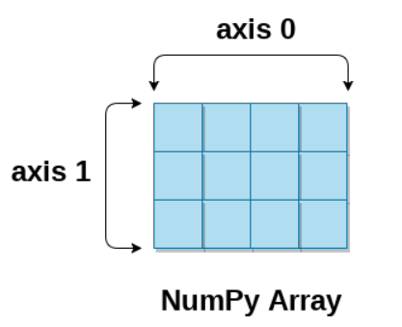
NumPy Array Axis
A NumPy multi-dimensional array is represented by the axis where axis-0 represents the columns and axis-1 represents the rows.

Slide 8
Array Functions
A.Reshape- changinging column and row order of the array
A.Min()
A.Max()
A.Sum()
Np.sqrt(a)
Np.std(a)

Slide 9
Array slicing
Array[start:end]
Array[start:end:step]

Slide 10
Arithmetic operations in array
A+b
A-b
A*b
a/b

Slide 11
Array Concatenation
a = np.array([[1,2,30],[10,15,4]])
b = np.array([[1,2,3],[12, 19, 29]])
Concatenate()
Hstack()
Vstack()

Slide 12
Numpy Creating Arrays
numpy.empty(shape, dtype = float, order = 'C’)
Shape: The desired shape of the specified array.
dtype: The data type of the array items. The default is the float.
Order: The default order is the c-style row-major order. It can be set to F for FORTRAN-style column-major order.
numpy.empty(shape, dtype = float, order = 'C’)
numpy.ones(shape, dtype = none, order = 'C')
numpy.zeros(shape, dtype = none, order = 'C')

Slide 13
Datatype conversion
astype() function creates a copy of the array, and allows you to specify the data type as a parameter.
newarr = arr1.astype('i')

Slide 14
Arrays from collections
create an array by using the existing data in the form of lists, or tuples
numpy.asarray(sequence, dtype = None, order = None)

Slide 15
Numpy Arrays within the numerical range
It creates an array by using the evenly spaced values over the given interval.
numpy.arrange(start, stop, step, dtype)

Slide 16
Array Iteration
nditer : Iterator object used to iterate over the given array using python standard Iterator interface.

Slide 17
Copy and View
The copy owns the data and any changes made to the copy will not affect original array, and any changes made to the original array will not affect the copy.
X=arr.copy()
The view does not own the data and any changes made to the view will affect the original array, and any changes made to the original array will affect the view.
y=arr.view()

Slide 18
Sorting and Searching Arrays
numpy.sort(input-array, axis, kind, order)
Input-It represents the input array which is to be sorted.
Axis- It represents the axis along which the array is to be sorted. If the axis is not mentioned, then the sorting is done along the last available axis.
Kind-It represents the type of sorting algorithm which is to be used while sorting. The default is quick sort.
order-It represents the filed according to which the array is to be sorted in the case if the array contains the fields.
Numpy.where()-used for searching

Slide 19
Array Filter
Getting some elements out of an existing array and creating a new array out of them is called filtering.
We filter an array using a boolean index list in numpy.

